Slide 1
Data Warehousing: Basic Concepts
Hannah Andrews and Angela Hughes

Slide 2
“A data warehouse is a subject-oriented, integrated, time-variant, and nonvolatile collection of data in support of management’s decision-making process.”—W. H. Inmon
Subject-Oriented
Integrated
Time-variant
Nonvolatile
This Photo by Unknown Author is licensed under CC BY
Notes:
A data warehouse is a copy of transaction data specifically structured for query and analysis.
Enterprise resource planning (ERP) is the integrated management of main business processes, often in real time and mediated by software and technology.
ETL stands for Extract, Transform and Load
Defined in many different ways, but not rigorously.
A decision support database that is maintained separately from the organization’s operational database
Support information processing by providing a solid platform of consolidated, historical data for analysis.
“A data warehouse is a subject-oriented, integrated, time-variant, and nonvolatile collection of data in support of management’s decision-making process.”—W. H. Inmon
Data warehousing:
The process of constructing and using data warehouses

Slide 3
Online analytical processing (OLAP) is used for analytics, while online transaction processing (OLTP) is used for transactions.
Notes:
https://www.datawarehouse4u.info/OLTP-vs-OLAP.html
“An operational database undergoes frequent changes on a daily basis on account of the transactions that take place. Suppose a business executive wants to analyze previous feedback on any data such as a product, a supplier, or any consumer data, then the executive will have no data available to analyze because the previous data has been updated due to transactions.
A data warehouses provides us generalized and consolidated data in multidimensional view. Along with generalized and consolidated view of data, a data warehouses also provides us Online Analytical Processing (OLAP) tools. These tools help us in interactive and effective analysis of data in a multidimensional space. This analysis results in data generalization and data mining. https://www.tutorialspoint.com/dwh/dwh_overview.htm“

Slide 4
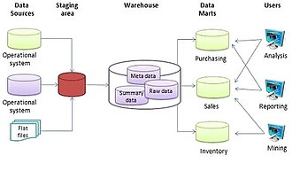
Data warehouses are organized around major subjects, such as customer, product, sales, etc.
Subject-oriented
This Photo by Unknown Author is licensed under CC BY-SA
Notes:
“Data warehouses are subject-oriented, meaning…”
Organized around major subjects, such as customer, product, sales
Focusing on the modeling and analysis of data for decision makers, not on daily operations or transaction processing
Provide a simple and concise view around particular subject issues by excluding data that are not useful in the decision support process

Slide 5
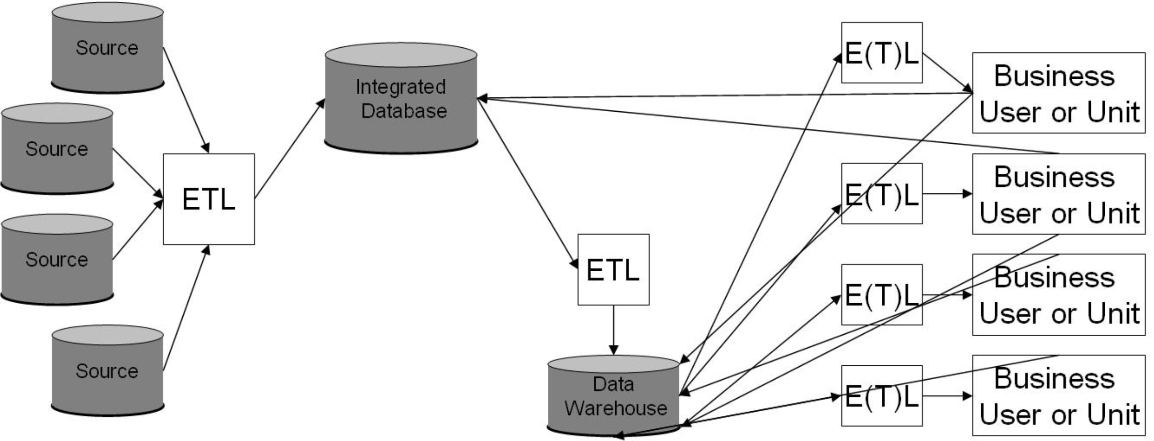
Data warehouses are constructed by integrating data from multiple heterogenous data sources.
Integrated
This Photo by Unknown Author is licensed under CC BY-SA
Notes:
Constructed by integrating multiple, heterogeneous data sources
relational databases, flat files, on-line transaction records
Data cleaning and data integration techniques are applied.
Ensure consistency in naming conventions, encoding structures, attribute measures, etc. among different data sources
E.g., Hotel price: currency, tax, breakfast covered, etc.
When data is moved to the warehouse, it is converted.

Slide 6
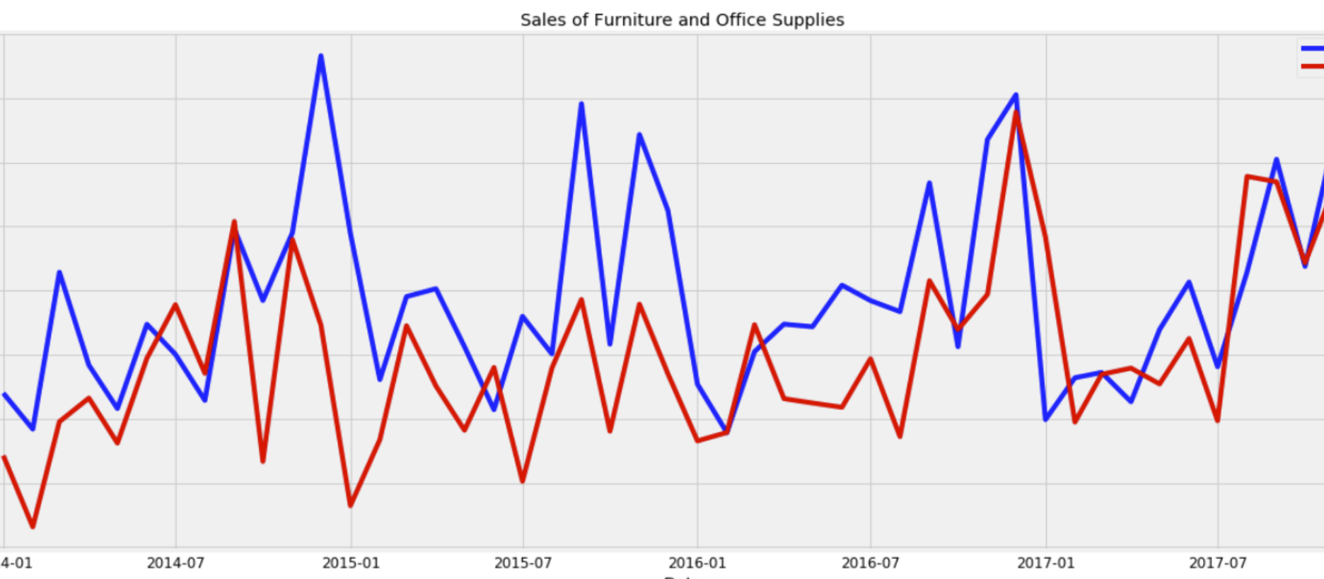
Data warehouses store historical data.
Time variant
Notes:
The time horizon for the data warehouse is significantly longer than that of operational systems
Operational database: current value data
Data warehouse data: provide information from a historical perspective (e.g., past 5-10 years)
Every key structure in the data warehouse
Contains an element of time, explicitly or implicitly
But the key of operational data may or may not contain “time element”
https://towardsdatascience.com/an-end-to-end-project-on-time-series-analysis-and-forecasting-with-python-4835e6bf050b

Slide 7
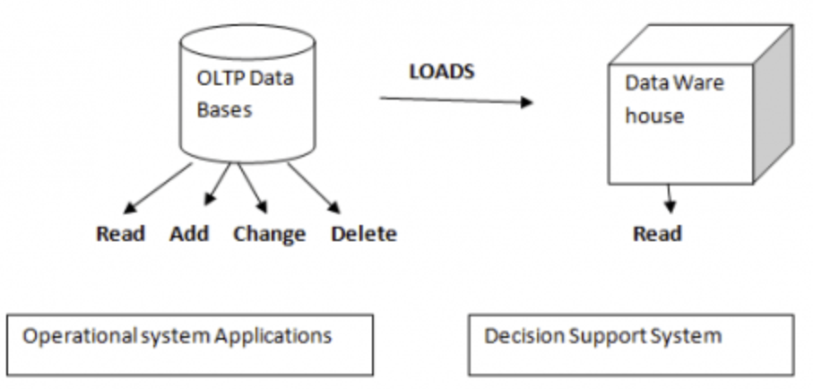
When new data is added to the data warehouse, previous data is not erased.
Non-volatile
Notes:
A physically separate store of data transformed from the operational environment
Operational update of data does not occur in the data warehouse environment
Does not require transaction processing, recovery, and concurrency control mechanisms
Requires only two operations in data accessing:
initial loading of data and access of data

Slide 8
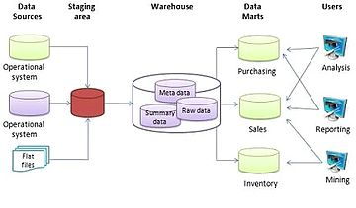
A multi-tiered architecture allows for higher performance and simplicity.
This Photo by Unknown Author is licensed under CC BY-SA
This Photo by Unknown Author is licensed under CC BY-SA
Notes:
High performance for both systems
DBMS— tuned for OLTP: access methods, indexing, concurrency control, recovery
Warehouse—tuned for OLAP: complex OLAP queries, multidimensional view, consolidation
Different functions and different data:
missing data: Decision support requires historical data which operational DBs do not typically maintain
data consolidation: DS requires consolidation (aggregation, summarization) of data from heterogeneous sources
data quality: different sources typically use inconsistent data representations, codes and formats which have to be reconciled
Note: There are more and more systems which perform OLAP analysis directly on relational databases

